Slide 1

Develop A Questioning Plan for Your Title IX Investigations
Bev Baligad, J.D.
Director of Compliance/Title IX Coordinator
University of Hawaii, West O’ahu
bevbaligad@gmail.com

Slide 2
After participating, you will be able to develop a questioning plan that guides a policy driven Title IX Investigation.

Slide 3
April 16, 2021
Section 1:
Review of a Policy-Informed Investigation & Understanding Relevance
Section 2:
Policy Grid Demo
Section 3:
Developing Your Own Questioning Plan

Slide 4
Disclosures
This presentation is not intended to be legal advice and is presented by the presenter for informational purposes only. Institutions should seek the advice of counsel before making any changes to policies and procedures related to this presentation.
The Department of Education requires institutions to publish or make available specific types of training related to grievance procedures and investigations. Since this presentation focuses solely on developing questions in preparation for an interview, this presentation is not intended to be used for the purposes of required training, as stated under 34 CFR §106.45(b)(1)(3) and may not be published online.

Slide 5
1
Review of a Policy-Informed Investigation & Understanding Relevance

Slide 6
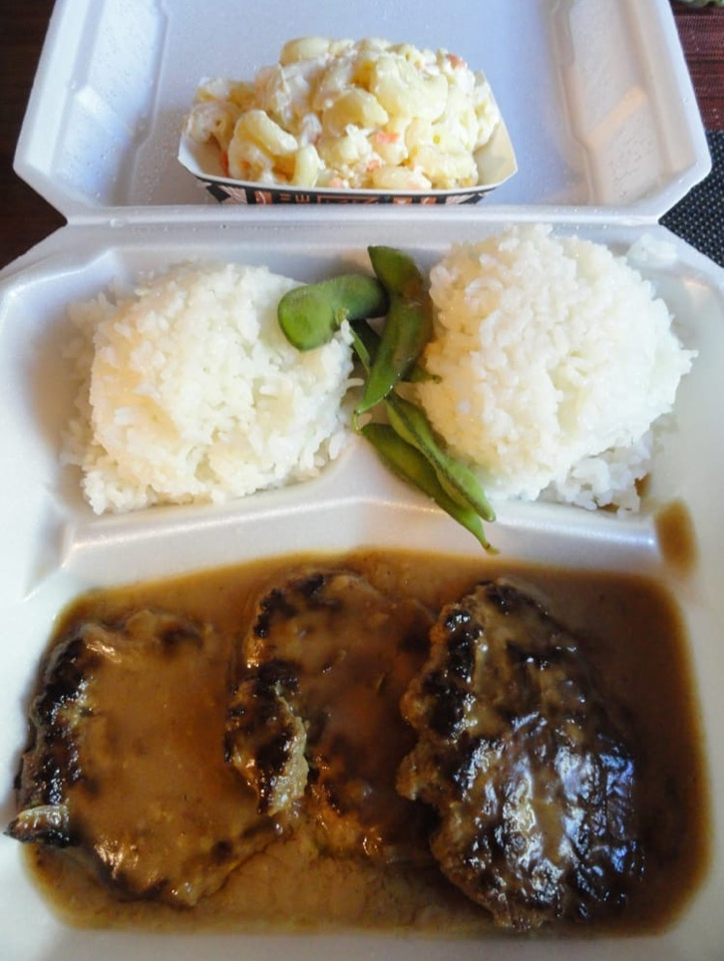
An Analysis Story:
Tom's Lunch

Slide 7
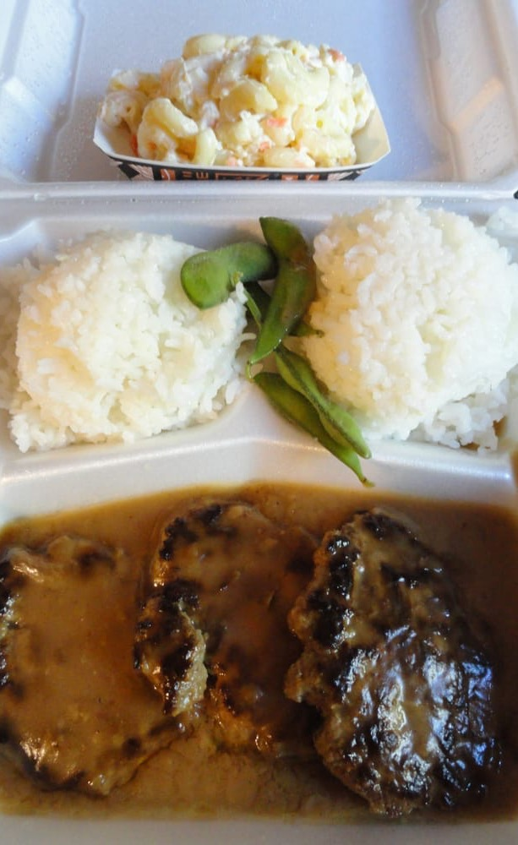
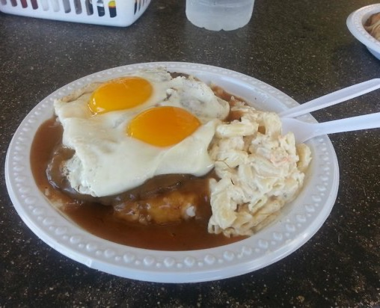
Which dish is a "Loco Moco?"
A Loco Moco is a popular dish in Hawaii made of rice, a hamburger patty, brown gravy, and eggs. Macaroni salad is optional.
7

Slide 8

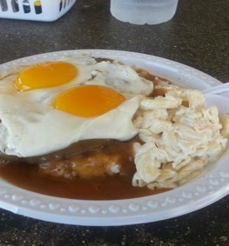
Definition: A Loco Moco is a popular Hawaii dish made of rice, a hamburger patty, brown gravy, and eggs. Macaroni salad is optional.​
Elements: | Lunch A (Tom’s Lunch) | Lunch B
Rice
Hamburger patty
Brown gravy
Egg(s)
Optional: Macaroni Salad
Was Tom’s Lunch a “Loco Moco?”

Slide 9
Understanding the Importance of an “Analysis”
Investigative reports must link the institutional policies/procedures to the facts.
Shows "elements" of the alleged sexual harassment (What kinds of facts should the investigator focus on?)
Assists the investigator in focusing on the right questions to ask
Helps to show the "relevancy" of the facts that are presented, as they relate to the policy (also helps with showing the information collected is “sufficient”)
“Gridding” helps to demonstrate the “reasonableness” of the investigation and supports the decision that a Decision Maker may make (“reasonable minds may differ”).

Slide 10
Factual Analysis:
The Importance of the “Grid”
“Gridding” is a methodical way of determining which information is necessary and relevant
Witness narratives may contain information that may be relevant and irrelevant to the allegations; gridding often help to keep information in order
Relevant facts (no matter the source) should support the elements of the policy (“gridding”)
It helps determine relevance and sufficiency of the evidence
Gridding helps the investigator stay focused and on task

Slide 11

Factual Analysis:
The Importance of the “Grid” (cont.)
When the facts are insufficient to show a policy violation, there is no policy violation.
When the quality/quantity of the facts appear equal (one party witness vs. one party witness), a credibility assessment may become extremely important. (Remember the Standard of Proof?)

Slide 12
Anatomy of an “Analysis” Approach
Make sure you use the correct institutional policy/policies or process(es).
Based on the information contained in the complaint, what potential type(s) of sexual harassment might you have? What makes you think that? (e.g., "If it looks like a duck, waddles like a duck, and quacks like a duck, it MIGHT be a duck.")
How does the policy define the specific behavior?
Break down the definition and list each “element.” (Think: Loco Moco ingredients!)

Slide 13
Some “Gridding” Suggestions
For each grid worksheet, focus on only ONE type of prohibited conduct (i.e., primary type of sexual harassment, sub analysis of a required term mentioned in the primary type, etc.) on a single worksheet.
Place a single element in each row; don’t overcrowd information within a single row. Give yourself a lot of space.
Use only relevant elements mentioned in a definition; don’t grid seemingly inapplicable portions of the definition(based on the facts as they are presented).
Learning how to grid (i.e., elemental breakdown, assigning notes, etc.) takes practice!

Slide 14
Some “Gridding” Suggestions (cont.)
Some institutions create “Gridding” worksheets so that the investigators won’t have to create a grid for the same definitions listed in a policy.
Use a clean grid for each witness; this will help investigators keep their information straight.
Ask yourself: According to the definition, what kinds of relevant information would I need to collect?
Once you get comfortable with gridding, you can design your own grid to help you build your own investigative efficiencies.

Slide 15

Relevance:
What is it?
Legal term
Federal Rules of Evidence (FREs)
FRE Rule 401. Evidence is relevant if:
  a) it has a tendency to make a fact more or less probable than it would be without the evidence; and,
  b) the fact is of consequence in determining the action
15

Slide 16
Relevance: What is it? (cont.)
Evidence must help to show that “something” is either true OR not true; or that it happened OR didn’t happen.
Administrative hearings are not subject to the FREs (unless they are adopted).
However, FREs serve as a good way ensure evidence is relevant.
The Title IX grievance procedure is considered an administrative process.
What is “inculpatory” vs. “exculpatory” evidence? [§106.45(b)(5)(ii)] Which one is “relevant?”
Basically know WHY you are asking a question (Slide 30) and make sure your questions are “relevant.”

Slide 17
Can relevant evidence be excluded? YES!
FRE Rule 403
If the reason for asking the question tends to cause the following:
  Unfair prejudice
  Confusing the issues
  Misleading the jury
  Undue delay
  Wasting time
  Needlessly presenting cumulative evidence
Notes:
If the reason for asking the question tends to cause the following:
[Probative value is substantially outweighed by danger of:]
Unfair prejudice
Confusing the issues
Misleading the jury
Undue delay
Wasting time
Needlessly presenting cumulative evidence

Slide 18
Other “Relevance” Considerations
Rape Shield Law
Information protected under a legally recognized? [§106.45(b)(1)(ix)]
What about “hearsay?” Can you use hearsay evidence?

Slide 19
Hearsay: What is it?
Example 1:
Witness A says: “I was standing right there and saw Car A run the red light and hit Car B.”
Example 2:
Witness B says: “My cousin told me that she was standing right there and saw Car B run the red light which caused Car A to hit them.”
Which one is hearsay?
What is the problem with hearsay?

Slide 20

Hearsay
What is hearsay?
An out-of-court statement offered by a party to establish the truth of the matter asserted.
It can be a document or a witness telling you what another witness said.
Hearsay evidence should have corroboration.
A Decision maker may “consider” hearsay evidence.
20

Slide 21
I. Relevant vs. Irrelevant Facts
Using information provided for the mock scenario, identify at least 2-3 potentially relevant and 2-3 potentially irrelevant facts from the case.
Place the relevant facts you identified above in the row of the appropriate element on your grid to help you analyze the facts provided.
Be prepared to discuss what relevant facts you identified and where you placed them on your grid with the group.
Notes:
45 minutes for these three parts – what handouts are needed besides Frank’s recording

Slide 22
Sufficiency: When is evidence “sufficient?”
Basically: did you gather enough information?
The institution’s “burden” [106.45(b)(5)(i)]
What can you do to ensure you’ve gathered sufficient evidence for the case?
How do you know when you gathered “sufficient” evidence, such where a decision maker can make an appropriate determination?

Slide 23
II. “Sufficient” information?
Review the information you placed on the worksheet for Activity 1: Relevant vs Irrelevant facts.
Are the facts presented in the mock scenario “sufficient?”
Can a Decision-Maker make a determination as to “whether more likely than not” a policy was violated based in the limited info provided in the scenario? Who or why not?
Be prepared to share your responses with the group.
Notes:
30 minutes for this exercise –

Slide 24
2
Policy Grid Demo

Slide 25
Definition: (Type of sexual harassment) is defined as_____________________.
Grid Example
Definition: (Type of sexual harassment) is defined as______________.
Element | Supporting Facts | Interview Questions
Element 1
Element 2
Element 3
Element 4
Element 5

Slide 26
II. Gridding: Analyzing the Potential Sexual Harassment
Using the attached Academic Institution (AI) Policy, review the type(s) of sexual harassment.
On the “Gridding Worksheet,” write down the type (choose only 1) of sexual harassment you chose to analyze for this case. Fill in the elements (one per row, use as many sheets as you need) based on the definition as it is written.
When you have completed your Grid, please be prepared to discuss it with the group.

Slide 28
3
Developing Your Own Questioning Plan

Slide 29
Developing Your Own Questioning Plan
What’s your investigative focus?
How do you determine what specific questions you need to ask the parties?
What happens when information is disclosed to the investigator that indicates another potential policy violation the institution never knew about?
How can you appropriately prepare for your witness interviews? Why would you ask specific questions?

Slide 30
Basic reasons why Interviewers would ask a witness a question
To establish rapport
To receive foundational/background information
To receive information specific to policy “elements”
To test witness credibility
To corroborate information
To verify/clarify previous facts provided
What are some other reasons why an investigator would ask a witness a question?
REMEMBER: The reason WHY you are asking the question is important.

Slide 31

Types of Questions
“Open-ended” — asking questions in a manner that allows the witness to provide a narrative (e.g., “What did you do last week?”)
“Leading” — you only want a “yes," “no,” or a very specific answer (e.g., “You went to the party at 615 Harriet Avenue on Friday the 13th, correct?”)
Start with open-ended and then narrow down the questions as the witness begins to give you more detail.

Slide 32
III. Develop some “relevant” questions
Using the “Gridding Worksheet” you prepared for Activity II, write corresponding questions for each element. If information was provided by the (C), think about asking clarifying or follow up questions when necessary.
Place questions in the “Interview Questions” column.
Pease be prepared to share your grid and discuss your identified questions with the group.

Slide 34


